Slide 1
Glaucoma Detection using Multi-task U-Net D-15
Malapati Kalyan Rohit – CB.SC.U4AIE23318
Renny Harlin D – CB.SC.U4AIE23334
Suganth K – CB.SC.U4AIE23340
Tharunkumar S – CB.SC.U4AIE23343

Slide 2
Introduction
What is Glaucoma ?
A chronic eye disease leading to irreversible blindness caused by optic nerve damage.
Characterized by "cupping," or the enlargement of the optic cup relative to the optic disc.
Clinical Metric
The standard diagnostic metric is the Cup-to-Disc Ratio (CDR).
Project Goal
To develop a comprehensive Multi-task U-Net framework optimized for the Drishti-GS1 dataset.
To emulate the clinical workflow by integrating segmentation maps directly into the screening pipeline

Slide 3
Literature Review
Author | Method | Database | Remark
Bajwa et al. 2019 | Two-stage CNN-based classification | ORIGA | Lower sensitivity compared to later CNN models Two-stage pipeline increases complexity
Sreng et al. 2020 | CNN-based landmark detection | Ophtha-EX | Trained on limited data Unable to perform precise segmentation
Latif et al. 2016 | CNN-based detection | Exudate detection | Small dataset Limited generalization capability
Li et al. 2018 | Fully Convolutional Residual Network (FCRN) | HEI-MED, e-Ophtha EX | Image resolution constraints High computational cost

Slide 4
Literature Review
Author | Method | Database | Remark
Hemelings et al. 2019 | Transfer learning with pre-trained CNN | DIARETDB1, e-Ophtha EX | Low sensitivity despite high accuracy Model stability issues
Zhao et al. 2020 | Residual network with supervised classifiers | DIARETDB1, e-Ophtha | Sensitive to learning rate selection Requires careful supervision

Slide 5
Input and Expected Output
Input data
Source: Retinal fundus images from the Drishti-GS1 dataset.
Preprocessing: Images are resized to 256x256 pixels and normalized.
Output data
Segmentation Masks: Pixel-wise masks for the Optic Cup and Optic Disc.
Binary Classification: A probability score indicating "Glaucoma" or "Normal".
Clinical Metric: Automated calculation of the Cup-to-Disc Ratio (CDR) derived from the predicted masks.

Slide 6
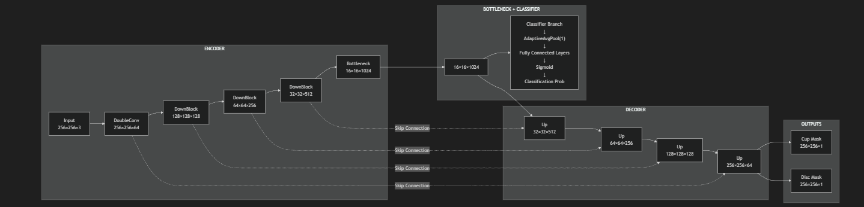
U-Net Architecture

Slide 7
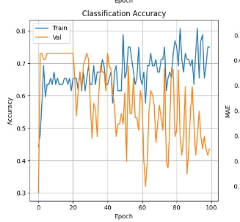
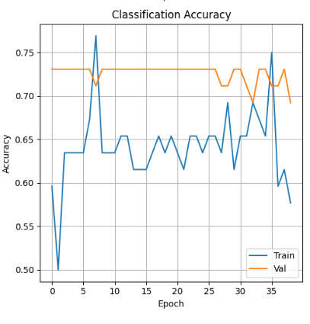
Patience – Early stopping

Slide 8
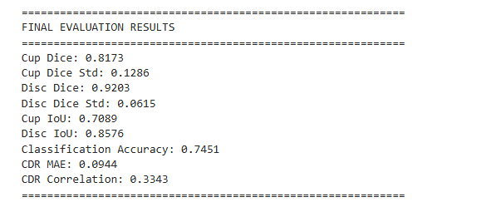
Results
With early stopping,

Slide 9
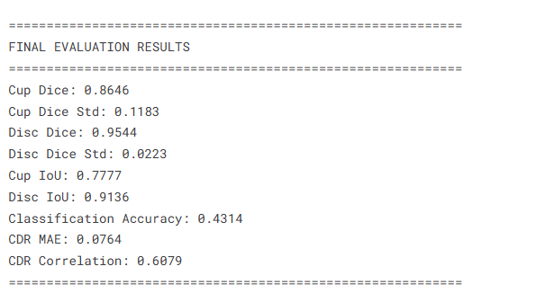
Results
Without early stopping,

Slide 10
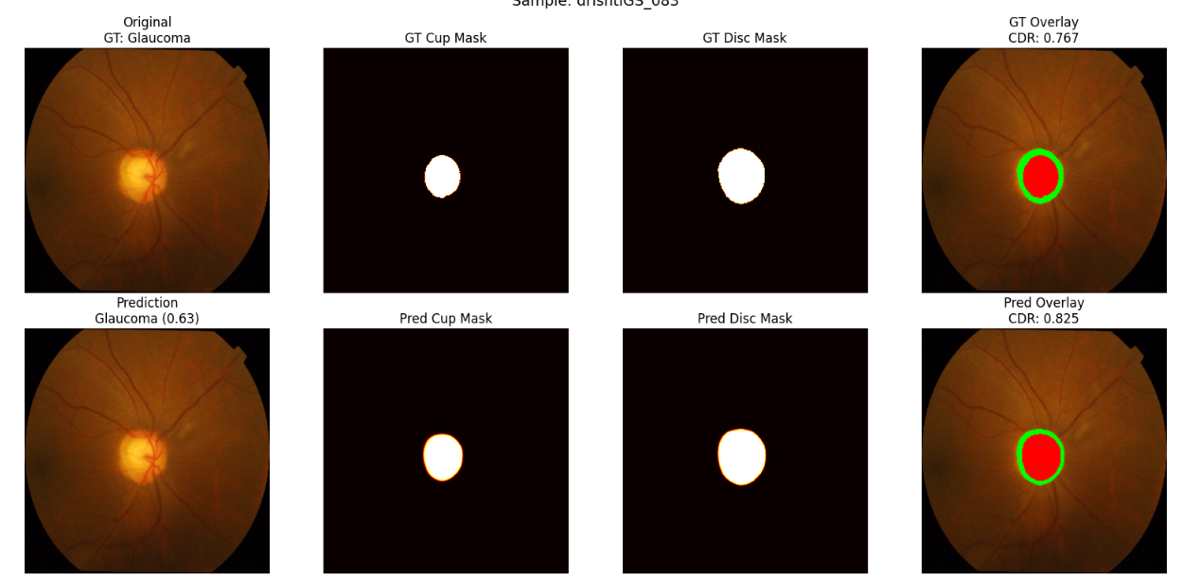
Output

Slide 11
References
Bajwa, M.N., Malik, M.I., Siddiqui, S.A. et al. Two-stage framework for optic disc localization and glaucoma classification in retinal fundus images using deep learning. BMC Med Inform Decis Mak 19, 136 (2019). https://doi.org/10.1186/s12911-019-0842-8
Sreng, S.; Maneerat, N.; Hamamoto, K.; Win, K.Y. Deep Learning for Optic Disc Segmentation and Glaucoma Diagnosis on Retinal Images. Appl. Sci. 2020, 10, 4916. https://doi.org/10.3390/app10144916
Latif, Jahanzaib, Tu, Shanshan, Xiao, Chuangbai, Rehman, Sadaqat Ur, Sadiq, Mazhar, Farhan, Muhammad, Digital Forensics Use Case for Glaucoma Detection Using Transfer Learning Based on Deep Convolutional Neural Networks, Security and Communication Networks, 2021, 4494447, 13 pages, 2021. https://doi.org/10.1155/2021/4494447
Li, L., Xu, M., Liu, H., Li, Y., Wang, X., Jiang, L., Wang, Z., Fan, X., & Wang, N. (2020). A Large-Scale Database and a CNN Model for Attention-Based Glaucoma Detection. IEEE transactions on medical imaging, 39(2), 413–424. https://doi.org/10.1109/TMI.2019.2927226
Hemelings, R., Elen, B., Barbosa-Breda, J., Lemmens, S., Meire, M., Pourjavan, S., Vandewalle, E., Van de Veire, S., Blaschko, M. B., De Boever, P., & Stalmans, I. (2020). Accurate prediction of glaucoma from colour fundus images with a convolutional neural network that relies on active and transfer learning. Acta ophthalmologica, 98(1), e94–e100. https://doi.org/10.1111/aos.14193
Beiji Zou, Zhiyou He, Rongchang Zhao, Chengzhang Zhu, Wangmin Liao, Shuo Li,8 Non-rigid retinal image registration using an unsupervised structure-driven regression network, Neurocomputing, Volume 404, 2020, Pages 14-25, ISSN 0925-2312, https://doi.org/10.1016/j.neucom.2020.04.122.

